Slide 1
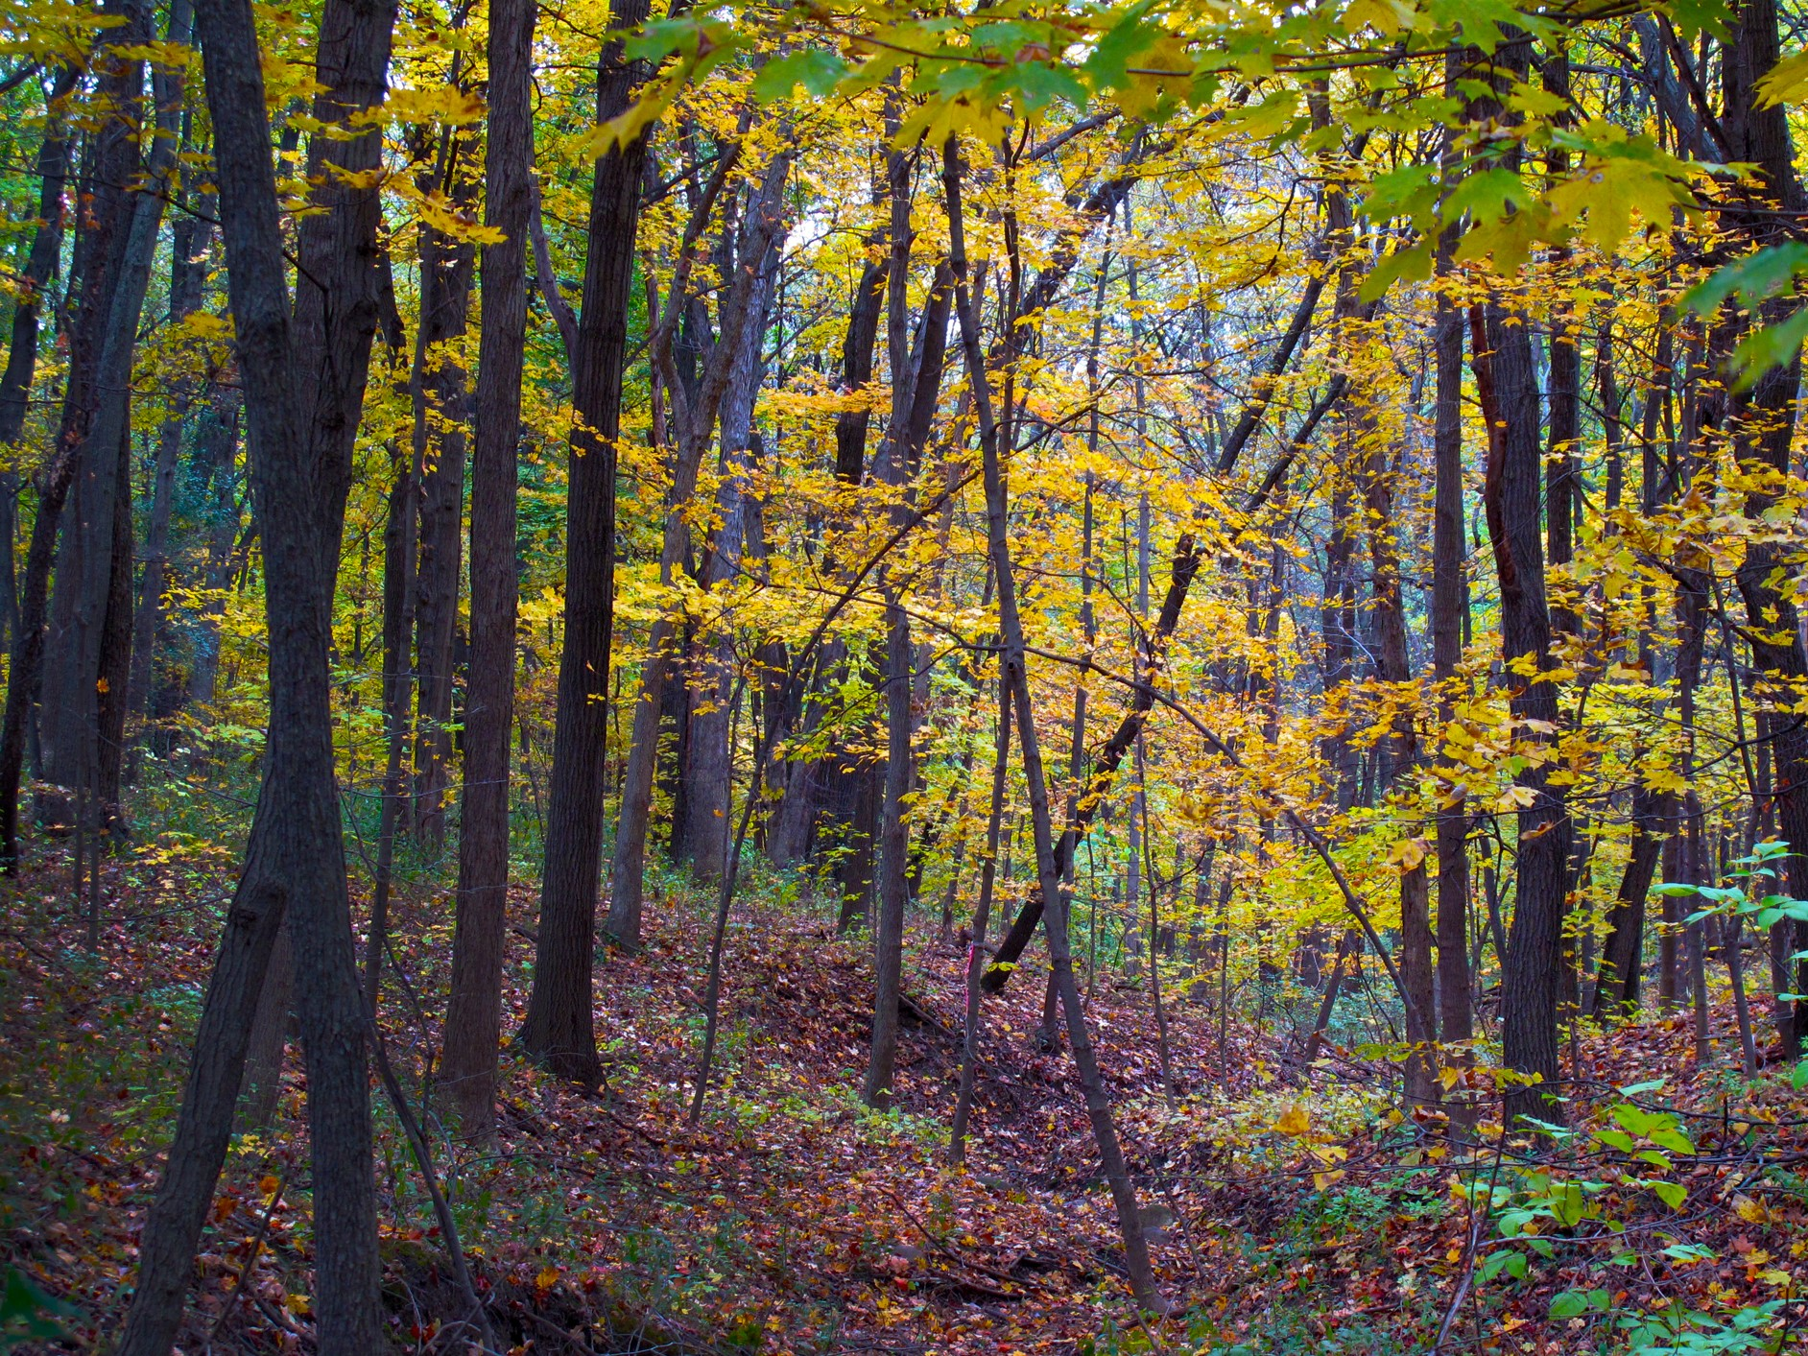
Washington State Trails Repository
Erika Whinihan & Elizabeth Yarbrough
Data Curation II
Spring 2021
Notes:
Intro:
Names
Class, iSchool, taught by Bree Norlander
We created a github repository for Washington State Trail Data

Slide 2
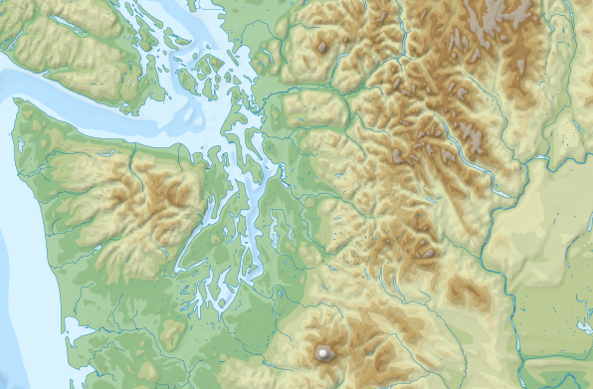
Project Background
&
Statement of Work
Data on trails in Washington state and in the U.S. and in other countries is often inconsistent, erroneous, and difficult to access
This repository will provide a comprehensive curation protocol for Washington state trail data
Notes:
Data on trails in Washington state and in the U.S. and in other countries is often difficult to find and exists in many different and often unusable formats (such as PDF files or maps).
There are inconsistencies across datasets and websites which makes comparison difficult.
This repository aims to provide a comprehensive curation protocol for trail data for Washington state and possibly expanded to other geographic regions.
By providing a user community, curated datasets, a collection policy, file naming guidelines, license requirements, and a metadata application profile, this repository can be a basic framework for trail data curation.

Slide 3



User Community
Policymakers & land managers
Conservationists & researchers
Recreational trail users
Notes:
When building the repository, we considered three different types of users that would use our repository
User 1: Local government policymakers & land managers: Policymakers can use these datasets as references and resources when creating governance and laws surrounding trail systems and public recreational areas.
User 2: Conservationists and researchers: Conservationists and researchers that are interested in studying trails and human impact on wildlife can use our repository to aid their research.
User 3: Recreational trail users. Individuals who use trails for recreational purposes would want to access trail information for their city/state or for a place they plan to visit where they do not know details of the trail system. They may want to know where the trailheads are located and specific characteristics of trails

Slide 4
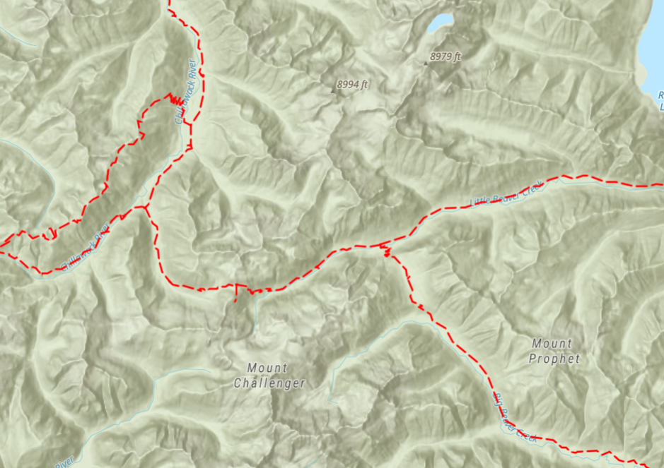
Collection Policy
Data Deposit Criteria
Open access & reusable
Contains digital files and documentation
Finalized to publish
Pertain to Washington state (local, county, state level)
Valid license
Files do not exceed 200GB.
Adherence to file naming conventions.
Preservation Guarantees
Review and approve deposits for long-term access
Set depositor responsibilities
Regular maintenance for all files to ensure access
Determine dataset removal from Repository
Notes:
The repository has policies in place that governs how data is deposited into the repository, how it is transformed upon input, and how the data is preserved for long-term access.
Some examples of criteria are that deposited data must be open access and reusable; contain both digital data files and accompanying documentation; pertain to washington state trails; and adhere to the file format and naming conventions
Once the data is accepted into the repository, data curators must review and transform deposits for long-term accessibility; conduct regular maintenance on data files; and create policies for removing data from the repository

Slide 5
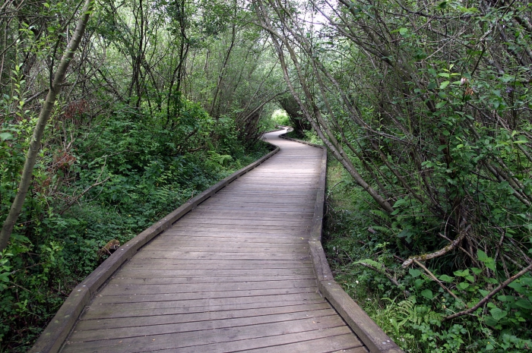
Data Transformations and Quality
Deposits are transformed when ingested into Repository following FAIR principles
Produces quality data that are complete, valid, accurate, and consistent
All deposits will follow Repository guidelines for submission, file format and naming, and Tidy Datasets
Data does not contain personal identifiable information and are validated by checksums
Notes:
It is important that the data within the repository is high quality and conforms to standards within the data curation community, such as the FAIR principles. Data must be findable, accessible, interoperable, and reusable.
All deposits will follow the guidelines for submission, file format and naming, and clean datasets.
In addition, the data should not contain any personally identifiable information and can be validated by checksums.

Slide 6
Metadata Application Profile
(MAP)
The MAP outlines the metadata requirements for data deposits
This includes geographical spatial data, temporal coverage, description of trails, license/rights information, and formats available
The MAP uses the Data Catalog Vocabulary (DCAT) metadata schema and the Dublin Core Terms vocabulary
Notes:
We created a metadata application profile, or MAP, as an outline for the required metadata elements that are needed to submit data to the repository. These elements are designed to allow the data to be findable and relevant to our user groups.
The MAP includes spatial data, time, trail name and description, license/rights information, and format.
We utilized Data Catalog Vocabulary metadata schema to inform our MAP.

Slide 7
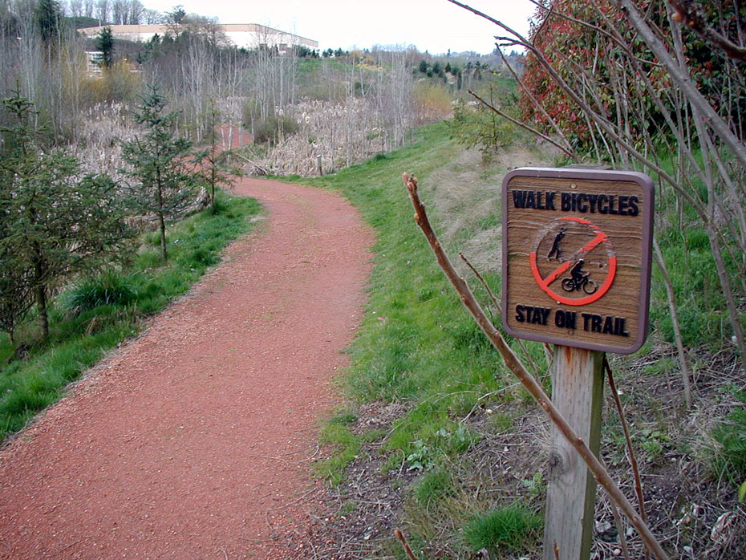
License
The Repository as a whole is under the Creative Commons Zero v1.0 Universal License to ensure data is open and accessible to anyone.
Every dataset in the Repository will be accessible to the public through our GitHub repository.
Notes:
The repository only accepts open access data that is free for the public to download and re-use. The entire repository is under the Creative Commons Zero Universal License.
Every dataset within the repository will be accessible to the public through our GitHub repository.

Slide 8
Acknowledgements
We would like to thank our instructor, Bree Norlander, who was invaluable throughout the process of creating this curation protocol. She answered so many questions for us and helped us along each step of the way.
We would also like to thank our classmates that came before us in Data Curation II for their wonderful protocol examples that were helpful in creating our own.
Notes:
Finally, we would like to thank our instructor Bree Norlander, who helped us tremendously throughout the making of this project. We would also like to thank the students in previous Data Curation classes for their protocol examples that were a fantastic resource.

Slide 9
Collection Policy Sources:
‌Data Collection Policy. (2014). Data Repository for U of M. Retrieved on April 27, 2021 from https://conservancy.umn.edu/pages/drum/policies/#data-collection-policy
GISGeography. (27 February 2021). The Ultimate List of GIS Formats and Geospatial File Extensions. Retrieved on April 28, 2021 from https://gisgeography.com/gis-formats/
Illinois Data Bank Preservation Policy. (3 May 2016). Retrieved on April 30, 2021 from https://www.ideals.illinois.edu/bitstream/handle/2142/91044/Illinois%20Data%20Bank%20Preservation%20Policy%202016-05-03.pdf?sequence=2&isAllowed=y
Start Deposit. (n.d.). ICPSR: Sharing data to advance science. Retrieved on April 27, 2021 from https://www.icpsr.umich.edu/web/pages/deposit/index.html
‌Data Transformations and Data Quality Sources:
‌All Best Practices.. (n.d.). DataONE: Data Observation Network for Earth. Retrieved on May 12, 2021 from https://old.dataone.org/all-best-practices
‌Broman, K.W. & Woo, K.H. (2018). Data Organization in Spreadsheets. The American Statistician, 72:1, 2-10, DOI: https://doi.org/10.1080/00031305.2017.1375989
‌Data Discovery Paradigms: User Requirements and Recommendations for Data Repositories. (8 January 2019). Data Science Journal, 18(1), p.3 DOI: http://doi.org/10.5334/dsj-2019-003
‌DataCite Fabrica. (n.d.). Retrieved on May 15, 2021 from https://doi.datacite.org/
‌flattenedFauna. (2019). Ingestion and Curation & Deposit Policy. Retrieved on May 12, 2021 from https://flattenedfauna.gitbook.io/practice-space/ingestion-and-curation-1
‌How to share data with a statistician. (8 November 2016). Retrieved on May 10, 2021 from jtleek/datasharing: The Leek group guide to data sharing (github.com)
‌The Ultimate List of GIS Formats and Geospatial File Extensions. (10 June 2020). OSGIS. Retrieved on May 15, 2021 from https://osgis.org/2020/06/the-ultimate-list-of-gis-formats-and-geospatial-file-extensions
VaxStats Repository. (2019). Ingest Policy and Deposit Policy. Retrieved on May 10, 2021 from https://vaxstats.gitbook.io/vax-stats/
‌Wickham, H. (August 2014). Tidy Data. Journal of Statistical Software, 59(10), 1-23.
Zenodo. (n.d.). Retrieved on May 15, 2021 from https://zenodo.org/
‌

Slide 10
Metadata Application Profile Sources:
‌CKAN (n.d.). The world’s leading open source data management system. Retrieved on May 18, 2021 from https://ckan.org/
‌Data Catalog Vocabulary (DCAT) - Version 2. (4 February 2020). W3C. Retrieved May 20, 2021 from https://www.w3.org/TR/vocab-dcat-2/
‌DCMI Metadata Terms. (20 January 2020). Dublin Core Metadata Initiative. Retrieved on May 20, 2021 from https://www.dublincore.org/specifications/dublin-core/dcmi-terms/
‌Definition of Shape_Lenth. (8 December 2017). Retrieved May 20, 2021 from https://support.esri.com/en/technical-article/000012873
‌Heery, R. & Manjula, P. (24 September 2000). Application Profiles: Mixing and Matching Metadata Schemas. ARIADNE: Web Magazine for Information Professionals. Issue 25. http://www.ariadne.ac.uk/issue/25/app-profiles/
‌Metadata. (31 January 2017). Data on the Web Best Practices. Retrieved on May 21, 2021 from https://www.w3.org/TR/dwbp/#metadata
‌R3 Recycling: Metadata Schema. (9 June 2017). Retrieved on May 21, 2021 from https://github.com/RochelleLundy/INFX-551-Spring2017/blob/master/r3Recycling/protocolReport/metadata/metadataSchema.md
Licensing Sources:
CC0 1.0 Universal (CC0 1.0) Public Domain Dedication. (n.d.). Creative Commons. Retrieved on May 26, 2021 from https://creativecommons.org/publicdomain/zero/1.0/
Common license types for datasets. (2021). data.world | Documentation. Retrieved on May 28, 2021 from https://help.data.world/hc/en-us/articles/115006114287-Common-license-types-for-datasets
Open Licenses. (n.d.). Project Open Data. Retrieved on May 26, 2021 from https://project-open-data.cio.gov/open-licenses/

